Slide 1
Exploring the American
“Kill Line”
Paul Zee-Cheng

Slide 2
Background
1.
Proposed by an international biology student in December 2025
2.
Gaming term used to describe poverty
3.
Picked up by MSN, NYT, and Qiushi
4.
Popular belief, anecdotal evidence gives the concept merit.
5.
Can we visualize a “Point of No Return?”
Notes:
Pop culture terminology taken from videogaming, where your character is so weakened that a single attack will lose you the game.
Applied to economics - a single economic shock will irreversibly damage the economic wellbeing of a person, such that they won’t recover.
NYT & MSN - propaganda
Qiushi - core theoretical journal of the Central Committee of the Communist Party of China
I wanted to ask:

Slide 3
NO.

Slide 4
Challenges to Kill Line Analysis
No Standard Framework for Poverty Measures
Wealth vs. Income; Different Income Measures; Defining Levels of Affluence, Defining Relative/Absolute Economic Shocks, Unit of Time, Unit of Household, Defining Resiliance/Fragility
Requires Longitudinal Analysis
OPM, SPM, PIT - snapshots
Intra- generational, not inter-generational
Raj Chetty’s Opportunity Atlas, Panel Study of Income Dynamics

Slide 5
What Can We Analyze?
STEP 1
STEP 2
STEP 3
Define Key Framework Concepts
Narrow Scope
Utilize available datasets
Notes:
Key Framework: Measure the impact of economic hardship, over time, and attempt to determine if lasting economic change
Narrow Scope:
Income, not wealth - huge portions of marginalized communities don’t have net wealth.
Intergenerational timeframe, in lieu of survey data over a lifetime
Rule out definitive analysis of a “point of no return”, especially with metrics such as homelessness (see 1996 NSHAPC survey)
PSID, Opportunity Atlas, national measures of cost-of-living, census data, geographic economic indicators, etcetera
NOT MIT Living Wage dataset or Alice datasets, for the moment, due to license requirements

Slide 6
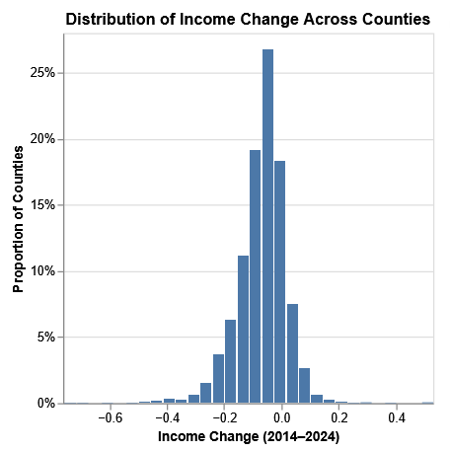
Dataset 1: Urban Institute’s Upward Mobility Initiative
Date
Notes:
Nationwide, down to the FIPS level, a framework of upward mobility defined by dignity & belonging, economic success, and power & autonomy.
24 economic and demographic predictors, nationwide, based on multiple datasets.
I wanted to simulate economic change over time, so I pulled the dataset, pulled living wage, calculated living wage over time, per county.

Slide 7
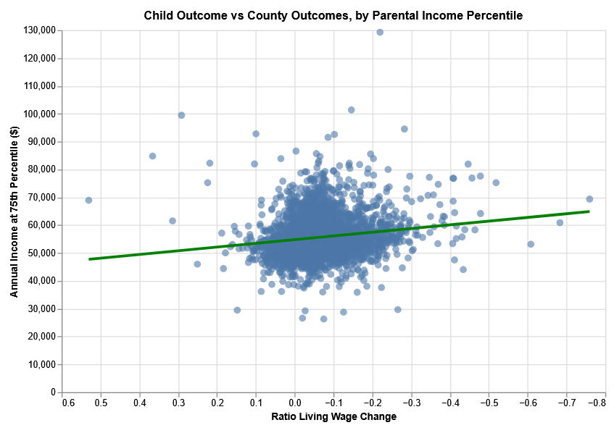
Dataset 2: Opportunity Atlas
Date
Notes:
Dr. Raj Chetty, leading scholar on intergenerational economic mobility at Harvard
Opportunity Atlas - two generations of kids, plus economic data about their parents, nationwide
Merged my living wage change data at county level
Regression of Children’s economic outcomes as it relates to county outcomes - p75

Slide 8
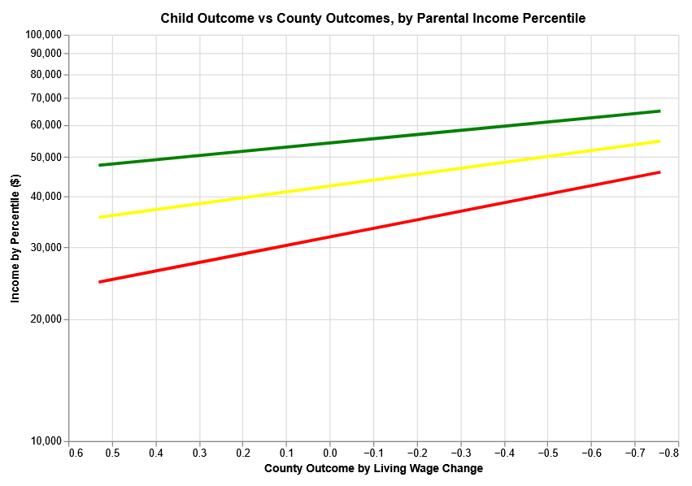
Dataset 2: Opportunity Atlas
Date
Notes:
Calculated Regression lines for three groups of kids - whose parents are in the 75th, 50th, and 25th income percentiles, respectively.
Logarithmic
CAUTION - cannot derive much from this data at this time. This is all counties, all incomes, and all demographics, and only the second cohort of children.
Paints a rosy picture of intergenerational wealth, wherein all younger generations benefit, even in countries that are the most hard hit.

Slide 9
Next Steps
Further break down Opportunity Atlas data by demographics, and Upward Mobility data by key factors
Streamlit Dashboard to visualize income over demographic trends
Access MIT Living Wage data, analyze PSID Response Data, ALICE data
Notes:
ALICE - Asset Limited, Income Constrained, Employed

